Slide 1
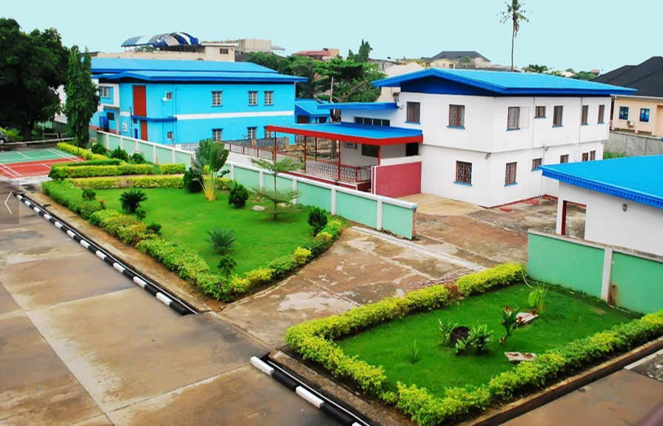

Survey of Programming Languages CSC 314 (3 UNITS) MODULE 1 OVERVIEW OF PROGRAMING LANGUAGES
www.trinityuniversity.edu.ng
DR.(MRS.) FOLASADE AYANKOYA

Slide 2

Lecture Overview
OVERVIEW OF PROGRAMING LANGUAGES
CONTENTS 1.0Objectives 2.0 Introduction 3.0 History of Programming Languages 3.1 Programming Paradigms 3.1.2 Programming Paradigms Definition

Slide 3
OBJECTIVES
At the end of this Module, you would have learnt:
About Language framework;
History of Programming
Programming Paradigms
Definitions of Different Paradigms and their examples.

Slide 4
Introduction and Overview - SPL
Language as a framework for problem-solving.
Programming languages are notations. They provide rules for programming—for specifying, organizing, and reasoning about computations.
Programming paradigms are ways of thinking about programming.
This course will discuss different programming languages and paradigms and compare their underlying concepts.
Design features of modern programming languages including flow control mechanism and data structures; techniques for implementation of these features.
The languages are compared with regard to their intrinsic data types and operations, control structures, implementation, and ease of use for various programming problems

Slide 5
History of PLs
Programming started in the 19th century between 1842-1843
Prominent names in the History of Program are Ada Lovelace (Memoir Translator – Bernoulli Numbers), Luigi Menabra (Italian Mathematician), Charles Babbage (Analytical Machine), Herman Hollerith (Punch Cards), John Von Neumann
First set of Computer Language was the Assembly Language (machine code) in 1940s which was error-prone and required a great deal of intellectual effort.
After Charles Babbage difference machine, the US Government built ENIAC in 1942 though it followed same principles of Babbage’s engine. Both processes are tedious.
1950s, first PLs designed to communicate instructions to a computer were written known as the high-level PLs

Slide 6
HISTORY OF PLs Contd
Turing machines set the basis for storage of programs as data in the John Von Neumann architecture of computers by representing a machine through a finite number; but does not serve well as basis for higher-level languages.
The first ever was Plankalkul, German Z3 developed by Konzad Zuse, 1943-1954
In 1949, John Mauchly wrote one of the first high-level PL for an electronic computer
Alick Glennie developed Autocde in early 1950s that uses a compiler to automatically convert the language to machine code.
The first code and compiler was developed in 1952 for the Mark 1 computer at the University of Manchester; also the first compiled high-level PL.
The 2nd Autocode was known as EDSAC 2 devised by D.F. Hartley of University of Cambridge in 1961

Slide 7
High-Level PLs
Another early PL was devised by the Short Range Committee, heavily supervised by Grace Hopper called FLOW-MATIC developed for UNIVAC 1 between 1955 and 1959. Flow-Matic was a written specification for English PL and major influence in the design of COBOL.
FORTRAN was developed at IBM in the mid 1950s and became the first widely used high-level general purpose PL.
Others include LISP (1958) by John McCarthy, ALGOL (late 1950s) by Committee of American and European Computer Scientists.
Syntax and semantics became more orthogonal with routines, recursive typing system, higher-order functions, etc… defined formally in terms of Van Wijngaarden grammer.

Slide 8
List of High-Level PLs - 1
1951 – Assembly Language
1952 – Autocode
1954 – IPL
1955 – FLOW-MATIC
1957 – FORTRAN
1957 – COMTRAN
1958 – LISP
1958 – ALGOL 58
1959 – FACT
1959 – COBOL
1959 – RPG
1962 – APL
1962 – Simula
1962 – SNOBOL
1963 – CPL
1964 – BASIC
1964 – PL/I
1966 – JOSS
1967 – BCPL
1968 – Logo
1969 – B
1970 – Pascal
1970 – Forth  1972 – C

Slide 9
PROGRAMMING PARADIGMS
Paradigm is defined as the various systems of ideas that have been used to guide the design of PLs although the design of a given language may reflect the influence of more than one paradigm.
Paradigm are different ways or styles in which a given program or programming language are organized.
It is also a typical example or model that form the basis of something; a philosophical or theoretical framework of any kind.
Programing Paradigms are categorised as : Imperative Programming and Declarative Programming these include:
Structural Paradigm
Procedural Programming
Object Oriented Programming
Logic Programming
Functional Programming

Slide 10
PROGRAMMING PARADIGMS
IMPERATIVE PARADIGM
DECLARATIVE PARADIGM
OBJECT ORIENTED PROGRAMMING
PROCEDURAL PROGRAMING
FUNCTIONAL PROGRAMING
STRUCTURED PROGRAMMING
LOGIC PROGRAMING

Slide 11
Programming Paradigms Definitions
Major Paradigms mostly referred to:
Imperative Programming – is the programming style based on specific operations described through statements, consequent commands and actions. Procedural and Object Oriented programming paradigms are all derivatives of the imperative style. Languages which reflect this paradigm recognize the fact that computers have re-usable memory that can change state; they are characterized by statements which affect the state of the machine
Declarative Programming – focuses on the what should be achieved rather than the how exactly; the command flow is not being specified but the focus is on the result. The functional PLs are declarative.

Slide 12
Procedural Programming – sometimes referred to as Conventional and/or Traditional is imperative-based type of programming and can be synonymous. It is built around the idea of building procedures, functions and/or routines. Although functions are also represented in the Functional programming, the Procedural style usually refers to the imperative paradigm.
Structural Programming – also known as modular programming is a term referring to PLs that support structured flow-control; it focuses on separation of concerns, modularity and reusability. All modern languages are structural, both imperative and declarative. Only old languages like Assembly Language do not support any structural syntax.
Object Oriented Programming – OOP paradigm is quite popular today, floating around the idea of classes (templates) and concrete instances representing objects from the real world and domain rather than from machine point of view. Encapsulation, Polymorphism, Abstraction and Inheritance are the top properties that characterize the Object Oriented programming style. Even though there are languages that are procedural in nature, some can be classified as object oriented also

Slide 13
Functional Programming – is a subtype of the declarative style. Programs written in functional languages are executed by evaluation expressions rather than statements that change some state, e.g. state of a variable. Although Functional programming is also structured, some of the control-flow constructs are not presented. They got only one return value and are deterministic; in pure functional languages, there are no loop statements; the only way is through recursion (repetition of steps to give result).
Logic Programming – this views computation as automated reasoning over a corpus of knowledge. Facts about the problem domain are expressed as logic formulae, and programs are executed by applying inference rules over them until an answer to the problem is found, or the collection of formulae is proved inconsistent. This paradigm also have the tendency of a declarative nature. Logic languages are useful for expressing problems where it is not obvious what the functions should do; it focuses on predicate logic.

Slide 14
Class Exercise from Today’s Lesson
Group the following PLs under the Paradigms that follows
Lisp, Prolog, Java, ADA, C, Ruby, C++, Python, C#, Perl, D, PHP, Smalltalk, Javascript, FORTRAN, VB.NET, COBOL
Paradigms:
Procedural
Logical
Object Oriented
Functional
Structural
Tip –Taking into consideration the definitions of the above paradigms, some PLs may fall under multiple or hybrid Paradigms…

Slide 15
Answers
Procedural PP – C, C++, COBOL, Basic, Algol, FORTRAN
Imperative PP – Lisp, Pascal, C, C++, Java, C#, JavaScript, Algol, Basic, Fortran, Perl, ADA, VB.NET
Functional PP – ML, Haskell, Clojure, Erlang
Object Oriented PP – C++, Java, C#, D, Eiffel, Objective-C, Smalltalk, Simula, Ruby, PHP, Python, Scala, F#...
Logic PP – Prolog,
Declarative PP - SQL
Structural PP – All modern PLs

